Slide 1
Digital Portfolio
STUDENT NAME: K.sriram
REGISTER Number: 2422k2219
NMID: 0E1382C525EB38A835A46D63016A8B45
DEPARTMENT: Computer science
COLLEGE: Puratchi thalaivi amma arts and science college, palladam

Slide 2
Project Tittle :DIGITAL PORTFOLIO
modern protfolio website with a clean,responsive,and user-friendly design
it includes dark mode feature and smooth animations
sections:
About me
skills
project
certificate
contact

Slide 3

AGENDA
Problem Statement
Project Overview
End Users
Tools and Technologies
Portfolio design and Layout
Features and Functionality
Results and Screenshots
Conclusion

Slide 4
PROBLEM STATEMENT
In today’s competitive enviroment,showcashing technical skills,projects,and Achievements is essential for carrer growth.Traditional resumes are limited In presenting interactive and visual content.There is a need for a Modren,responsive,and personalized protfolio website that highlights my Skills,projects,and certicates in a professional way.

Slide 5

PROJECT OVERVIEW
The Digital Portfolio website is a personal website built to highlight academic Background, technical skills, projects, certificates, and contact details. It Provides recruiters and peers with a professional, interactive, And modern Way to view achievements.

Slide 6

WHO ARE THE END USERS?
Recruiters/HR Managers
College Faculty for Evaluation
Fellow Developers & Collaborators
Internship/Job Providers

Slide 7

TOOLS AND TECHNIQUES
Frontend: HTML5, CSS3, JavaScript
Icons: Font Awesome
Animation & Effects: Typing effect, Dark mode toggle, Smooth scrolling
Hosting: GitHub Pages
Tools:VS CODE

Slide 8
POTFOLIO DESIGN AND LAYOUT
Clean, modern single-page layout
Sections: Home, About Me, Skills, Projects, Certificates, Contact
Responsive design with dark mode support
Smooth navigation and UI-friendly interactions

Slide 9
FEATURES AND FUNCTIONALITY
1. Navigation Buttons – Sections like About, Certificates, Experience, Education, Skills, Contact link to respective parts of the page.
2. About Section – Short introduction about me.
3. Certificates Section – Display list or images of certifications.
4. Experience Section – Show past projects, internships, or work experience.
5. Education Section – Academic details with year & institution.
6. Skills Section – List technical & soft skills (with progress bars or icons if needed).
7. Contact Section – Email, phone, or contact Number and my details

Slide 10
RESULT
Working portfolio website hosted online
Successfully displays personal details, projects, and certificates
Easy navigation and user-friendly UI
Attracts recruiters by showcasing both skills and creativity

Slide 11
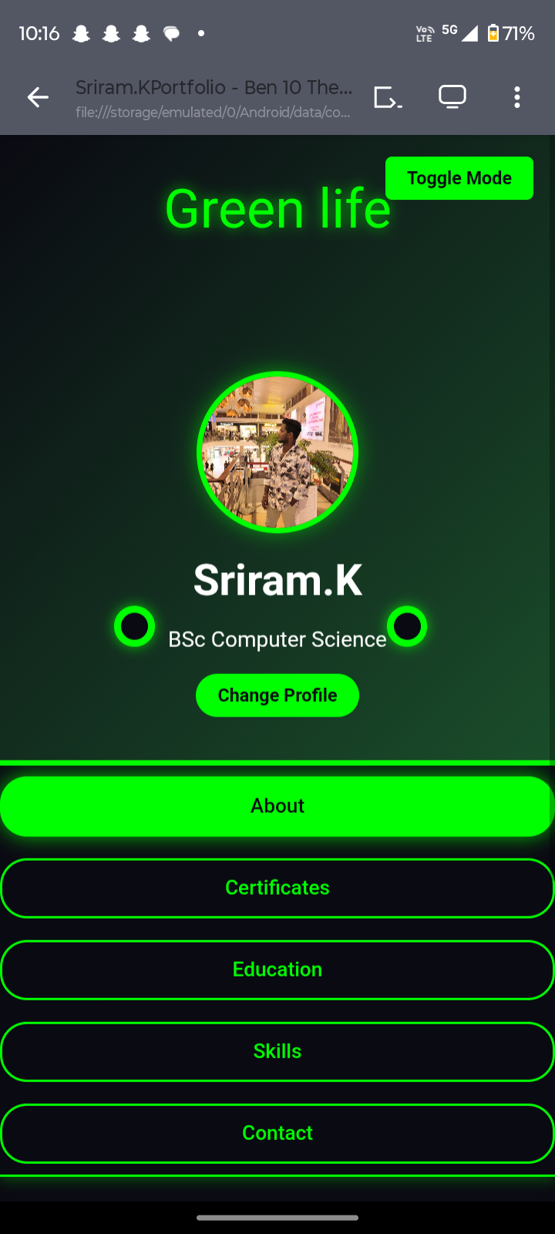
Screen shot 1

Slide 12
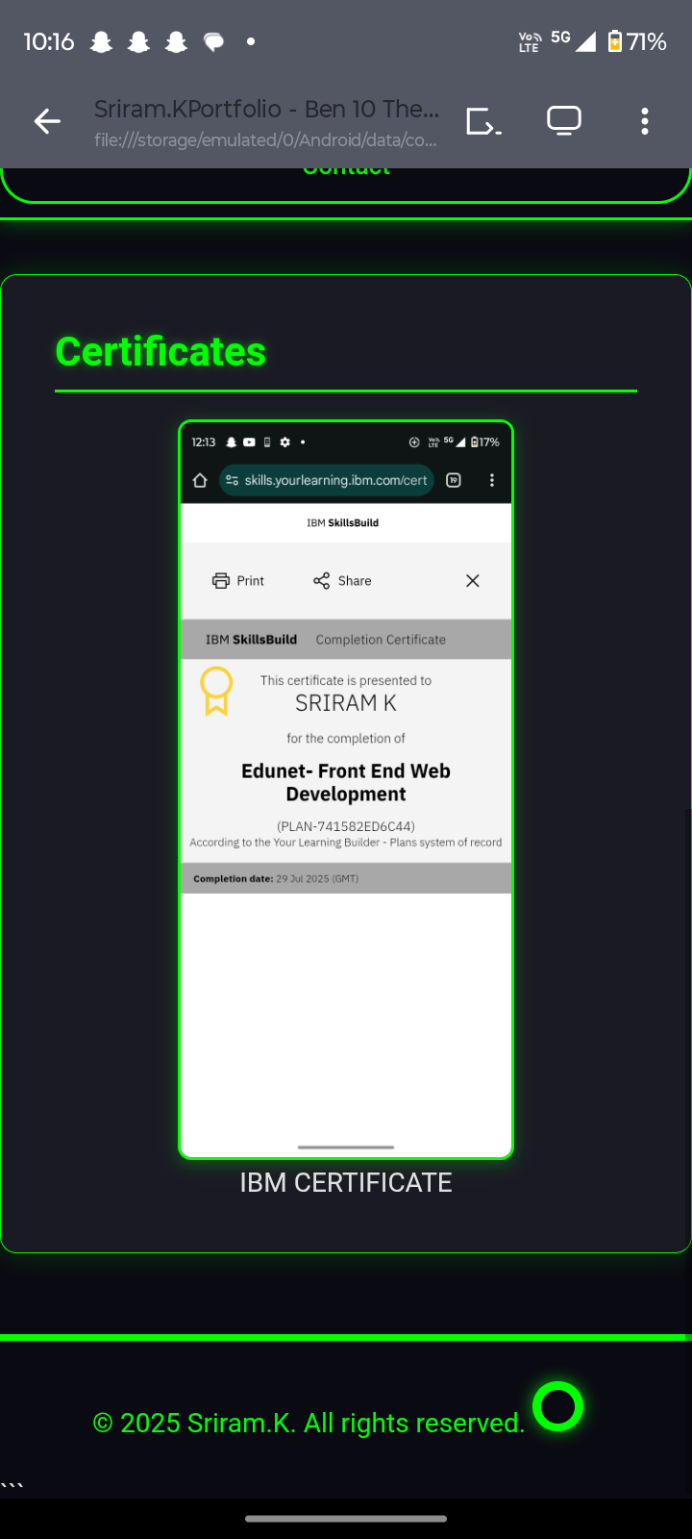
SCREEN SHORT 2

Slide 13
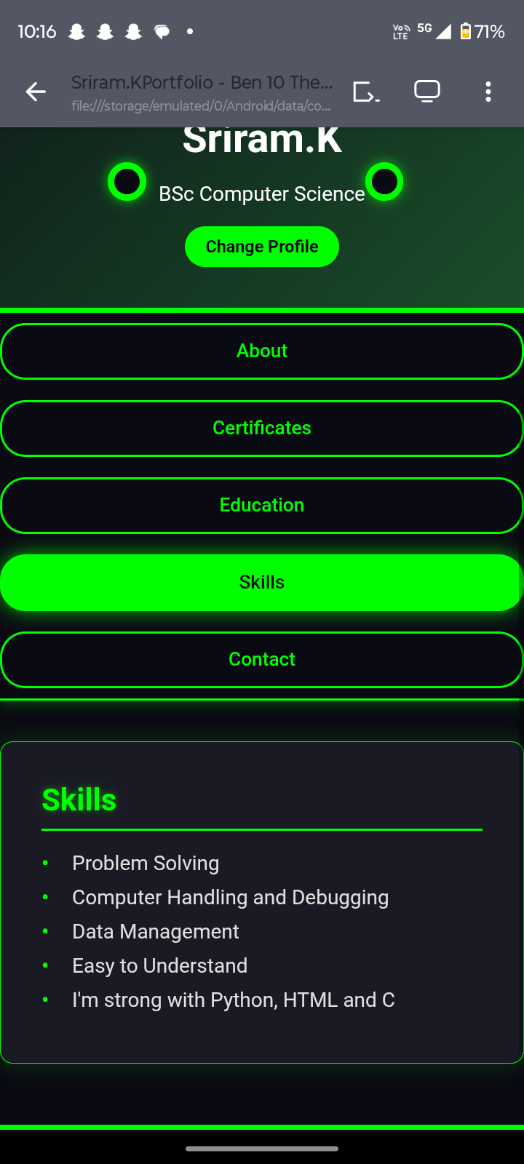
SCREEN SHORT 3

Slide 14
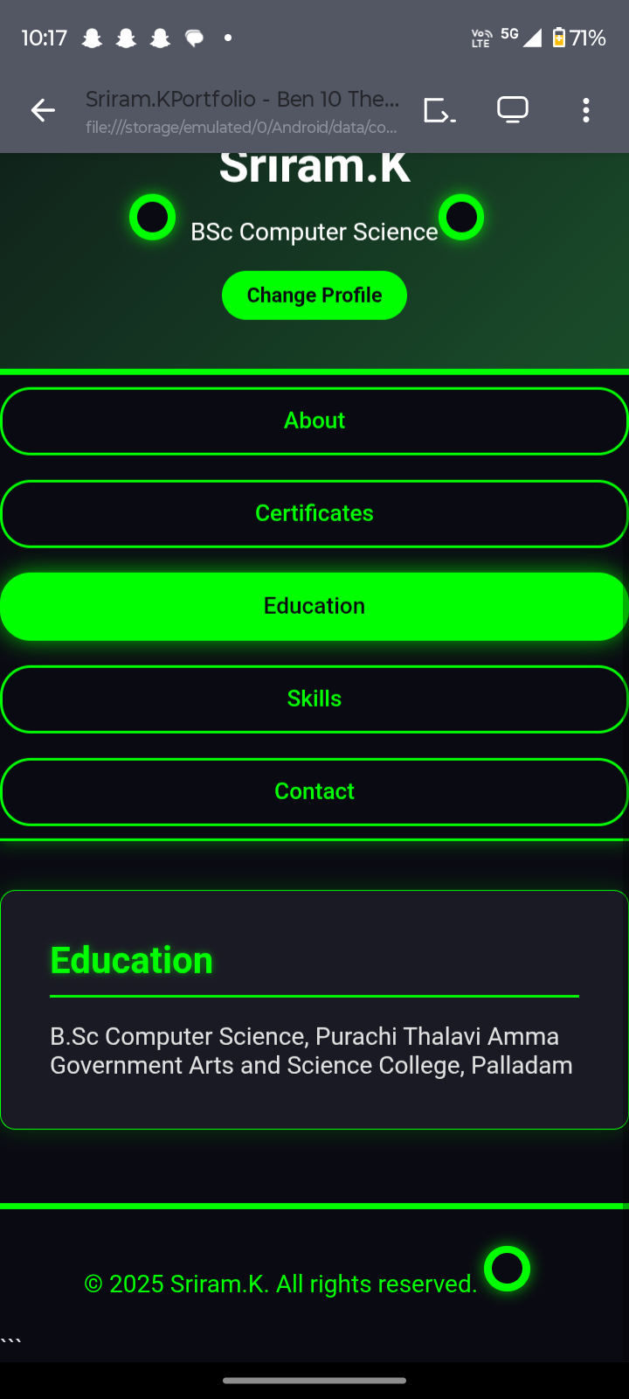
SCREEN SHORT 4

Slide 15
Conclusion
The digital portfolio acts as a modern resume, improving online visibility, Professionalism, and opportunities for internships and jobs. It Demonstrates both technical skills and personal branding.

Slide 16
THANKS

